Slide 1
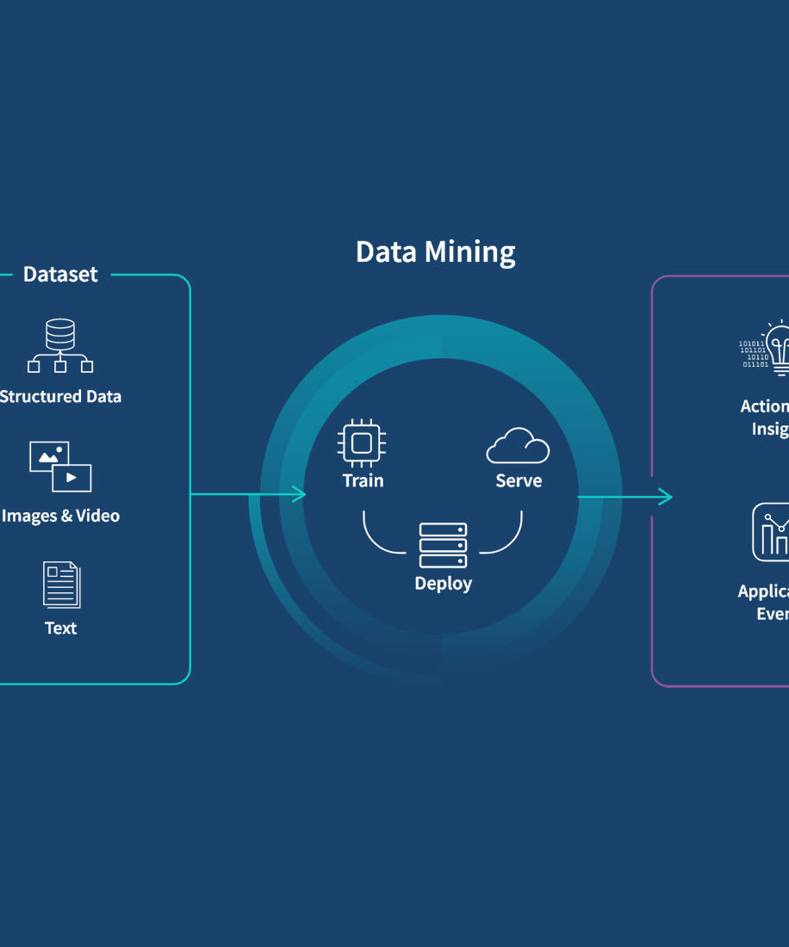
Introduction to
Data Mining
Vaishnavi Singh [RA2311003030580]
CSE Core- I

Slide 2




What is Data Mining?
Extraction of useful
information
Analyzing complex
datasets
Discovering hidden
trends and relationships
Informed decision-
making
Data mining is the
process of uncovering
valuable insights and
patterns from large
datasets
Data mining techniques
are used to make sense
of the ever-growing
volumes of data
generated by
organizations
Data mining helps
identify previously
unknown correlations,
patterns, and trends
within data
The insights gained
from data mining can
help organizations
make data-driven
decisions and
strategic choices
As data continues to grow exponentially, data mining offers powerful techniques to unlock
the full potential of data and drive informed decision-making across various industries.

Slide 3
Data Mining vs. Data Analytics
Comparing the focus, techniques, and outcomes of data mining and data analytics
80%
75%
70%
60%
50%
Backward-looking
Analysis
Forward-looking
Prediction
Automation Level
Actionability of
Insights
Breadth of Data
Sources

Slide 4


Data Mining vs. Machine Learning
Characteristic
Data Mining
Machine Learning
Origin
Traditional databases with unstructured data
It has an existing algorithm and data
Meaning
Extracting information from a huge amount of data
Introduce new Information from data as well as previous experience
History
In 1930, it was known as knowledge discovery in databases (KDD)
The first program, i.e., Samuel's checker playing program, was established in 1950
Responsibility
Data Mining is used to obtain the rules from the existing data
Machine learning teaches the computer, how to learn and comprehend the rules
Abstraction
Data mining abstract from the data warehouse
Machine learning reads machine
Applications
In compare to machine learning, data mining can produce outcomes on the lesser volume of data. It is also used in cluster analysis
It needs a large amount of data to obtain accurate results. It has various applications, used in web search, spam filter, credit scoring, computer design, etc.
Nature
It involves human interference more towards the manual
It is automated, once designed and implemented; there is no need for human effort
*Adapted from the provided context

Slide 5







The KDD Process
Transforming the data into
appropriate forms suitable for
mining, including
normalization, attribute
selection, and discretization.
Removing noisy, inconsistent,
and irrelevant data from the
collection to improve data
quality.
Combining heterogeneous data
from multiple sources into a
common data source or data
warehouse.
Identifying and retrieving the
relevant data from the data
collection for the data mining
process.
Data Cleaning
Data Integration
Data Selection
Data Transformation
Data Mining
Pattern Evaluation
Knowledge
Representation
Applying intelligent methods
and algorithms to extract
patterns, trends, and insights
from the prepared data.
Evaluating the discovered
patterns to identify the most
interesting and useful ones
based on defined measures.
Presenting the discovered
knowledge in a way that is
understandable and useful for
the end-users, often using
visualization tools.

Slide 6
Data Mining Architecture
Data Source
Data Preprocessing
Database or Data Warehouse
Server
The actual source of data, such
as databases, data warehouses,
the World Wide Web, and other
documents.
Data cleaning, integration,
selection, and transformation to
prepare the data for mining.
The server that stores the
cleaned and integrated data,
ready to be processed by the
data mining engine.
Data Mining Engine
Pattern Evaluation Module
Graphical User Interface
The core component that contains
various modules for performing
data mining tasks, such as
association, classification,
clustering, and prediction.
Responsible for measuring the
interestingness of patterns and
focusing the search on exciting
patterns.
Enables user interaction with
the data mining system and
displays the results.

Slide 7
Types of Data for Mining
Flat Files
  Data files in text or binary form with a simple structure that can be
  easily extracted by data mining algorithms. Flat files have no
  relationships or paths between the data elements, like a relational
  database stored on a flat file.
Relational Databases
  Collections of multiple data sets organized into tables, records, and
  columns, allowing data to be accessed in various ways without needing to
  know the database structure. Relational databases use SQL as the standard
  API for data access and manipulation.
Data Warehouses
  Technologies that collect data from various sources within an organization
  to provide meaningful business insights. Data warehouses are designed for
  data analysis rather than transaction processing, and can be enterprise-
  wide, departmental (data marts), or virtual.
Object-Relational Databases
  A combination of object-oriented and relational database models, supporting
  features like classes, objects, and inheritance, bridging the gap between
  programming language practices and relational database structures.
Transactional Databases
  Databases that have the capability to undo a transaction if it is not
  performed correctly, following the ACID (Atomicity, Consistency, Isolation,
  Durability) properties of database management systems.
Multimedia Databases
  Databases that store complex information in pre-specified formats,
  including audio, video, images, and text media, often stored on object-
  oriented databases.
Spatial Databases
  Databases that store geographical information like maps, and global or
  regional positioning data, in the form of coordinates, topology, lines, and
  polygons.
Time-series Databases
  Databases that contain time-related data, such as stock market data or
  logged activities, which often require real-time analysis to study trends
  and correlations between variables over time.
World Wide Web
  The most heterogeneous data repository, collecting data from multiple
  sources in the form of documents, resources, audio, video, and text,
  accessible through web browsers and the internet network.

Slide 8
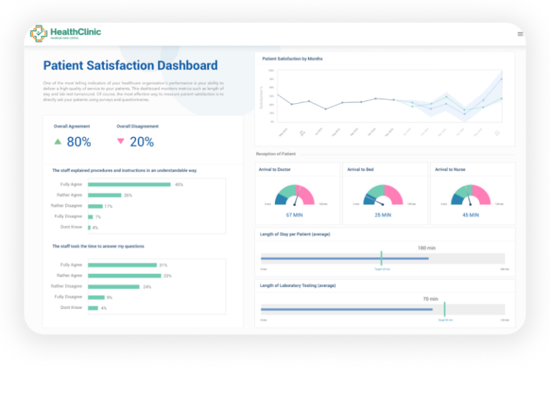
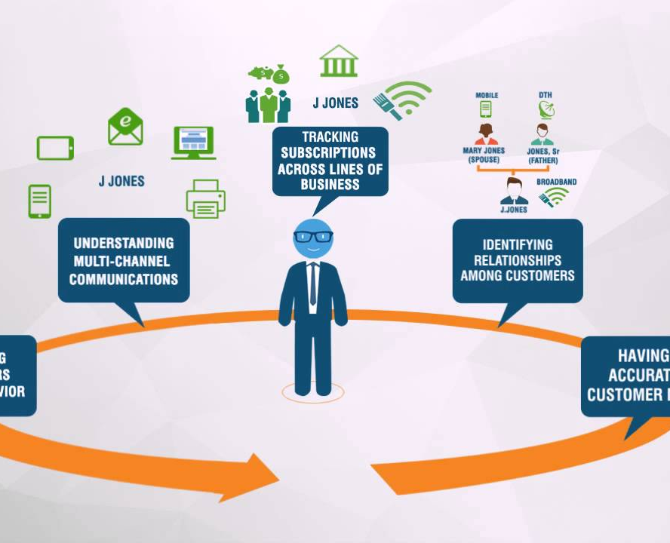
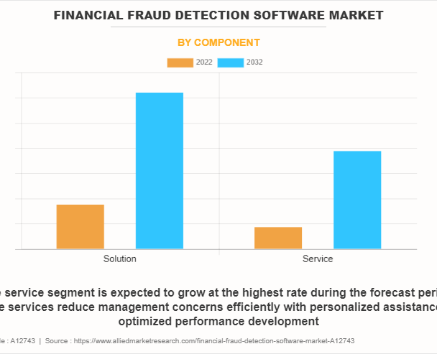
Applications of Data Mining
Healthcare Analytics
Retail Personalization
Financial Fraud Detection
Data mining techniques used to
predict disease outbreaks,
identify high-risk patients, and
optimize treatment plans
Applying data mining to
understand customer preferences,
target marketing campaigns, and
optimize product placement
Using data mining to identify
suspicious transactions, prevent
credit card fraud, and monitor
investment portfolio risks

Slide 9
Data Mining Functionalities
Characterization
  Summarizes general features of objects in a target
  class and produces characteristic rules
Discrimination
  Compares the general features of a target class
  against contrasting classes to produce discriminant
  rules
Association Analysis
  Discovers association rules that represent the
  frequency of items occurring together in
  transactional data
Classification
  Identifies a model that distinguishes data classes
  and concepts based on a training set of labeled data
Prediction
  Forecasts missing values, trends, or class labels
  based on patterns in the data
Clustering
  Groups similar data objects into clusters based on
  their characteristics, without predefined classes
Outlier Analysis
  Identifies anomalous data elements that cannot be
  grouped into the given classes or clusters
Evolution and Deviation Analysis
  Studies how data changes over time and identifies
  deviations from expected values

Slide 10







Challenges in Data Mining
Handling Incomplete and Noisy Data
Addressing Data Distribution and Scalability
Ensuring Data Privacy and Security
Improving Data Visualization
and Interpretation

Slide 11
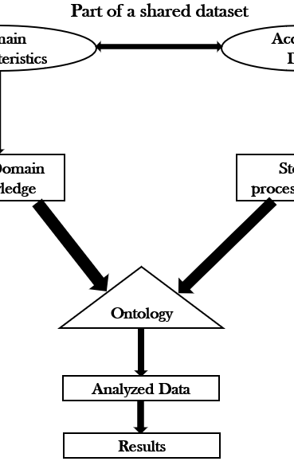
Data Preprocessing
and Data Quality
Effective data mining relies heavily on the quality
and preprocessing of the underlying data. Data
preprocessing is a crucial step that transforms raw
data into a format suitable for analysis, addressing
issues such as missing values, noise, and
inconsistencies. By ensuring high-quality data,
organizations can extract meaningful insights and
make informed decisions with confidence.

Slide 12
Data Integration
Combining Data from Multiple Sources
Resolving Entity Identification Issues
Addressing Data Conflicts
Data integration involves merging data
from heterogeneous sources, such as
databases, flat files, and data cubes, to
create a unified view of the data.
When integrating data, it is crucial to
match real-world entities from different
data sources, even if they have different
identifiers (e.g., customer_id vs.
customer_number).
Data integration must resolve conflicts
where the same entity has different
attribute values across data sources,
such as a hotel room price represented in
different currencies or with different
services.
Eliminating Redundancy and Inconsistencies
Improving Data Quality
The data integration process should identify and remove redundant
or inconsistent data, ensuring a clean and consistent dataset for
data mining.
Effective data integration helps enhance the overall quality of
the data by addressing issues like missing values, data
discrepancies, and structural differences across sources.

Slide 13
Data Reduction Techniques
Dimensionality Reduction
  Reducing the number of attributes or features in a dataset to improve data
  mining efficiency, including techniques like Wavelet Transform, Principal
  Component Analysis (PCA), and Attribute Subset Selection.
Numerosity Reduction
  Representing the data in a smaller form through parametric models like
  regression or non-parametric methods like histograms, clustering, sampling,
  and data cube aggregation.
Wavelet Transform
  A lossy dimensionality reduction method that transforms the data into
  wavelet coefficients, allowing the dataset to be compressed by retaining
  only the most significant coefficients.
Principal Component Analysis (PCA)
  An orthogonal linear transformation that identifies the principal
  components (directions of maximum variance) in the data, allowing the
  dataset to be projected onto a lower-dimensional space while retaining most
  of the original information.
Attribute Subset Selection
  Identifying and removing irrelevant or redundant attributes from the
  dataset using statistical significance tests, greedy approaches like
  forward selection and backward elimination, or decision tree induction.
Clustering
  Grouping similar data points together, reducing the dataset to a smaller
  number of representative cluster centroids.
Sampling
  Selecting a representative subset of the data, such as simple random
  sampling, stratified sampling, or cluster sampling, to reduce the
  computational complexity of data mining.
Data Cube Aggregation
  Representing the data at different levels of granularity using a multi-
  dimensional data cube, allowing for more efficient aggregation and
  summarization.
Data Compression
  Encoding the data in a more compact form, either losslessly or with some
  loss of information, to reduce the storage and processing requirements.

Slide 14
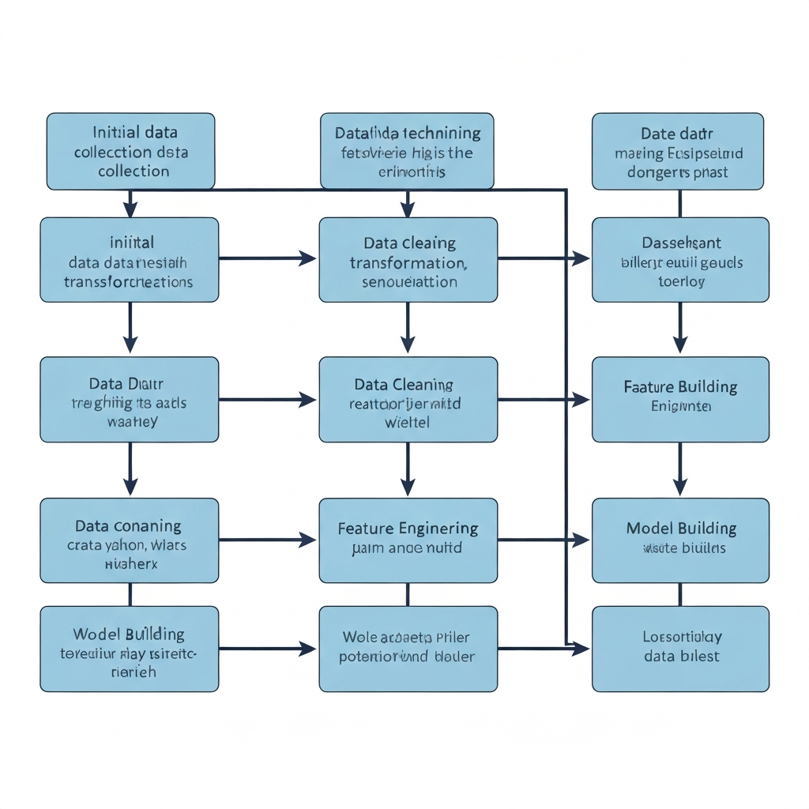
As the volume of data continues to grow
exponentially, the field of data mining
offers powerful techniques to extract
valuable insights and drive informed
decision-making. By understanding the
key concepts, architectures, and diverse
applications of data mining, organizations
can unlock the full potential of their data
and stay ahead in the rapidly evolving
digital landscape.

Slide 15
Thoughts? Questions?

